Slide 1
IT150 Web Design
Final Project
By Brian St-Juste

Slide 2
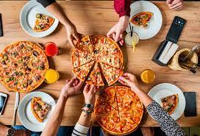
Introduction
Empire Pizza has been serving delicious, hand-crafted pizzas to our community since the 60s. Our mission is to continue providing high-quality, authentic pizzas using only the freshest ingredients and time-honored techniques. We are committed to giving our customers an enjoyable dining experience, whether they dine-in, take-out, or have their pizza delivered. We strive to be a cornerstone in our community and to be known as the go-to spot for mouth-watering pizza.

Slide 3
Goals
The goal and purpose of the old restaurant having a website would be to provide customers with easy access to important information about the restaurant, such as its menu, hours of operation, location, and contact information. A website would also allow the restaurant to reach a wider audience and to attract new customers by showcasing its offerings and unique qualities. Additionally, a website could provide an online ordering platform for customers who want to place take-out orders or make reservations. Overall, a website would help the restaurant to improve its customer service and to stay competitive in the modern marketplace.

Slide 4
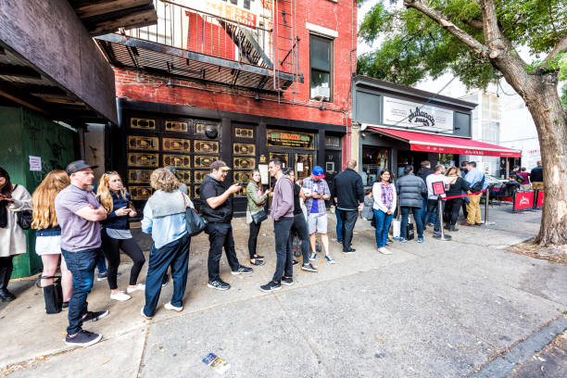
Target Audience
In general, a restaurant's target audience could include anyone who lives in the area and enjoys the type of food that the restaurant serves. This could include families, young professionals, students, seniors, and tourists, among others. The restaurant may also have specific demographics that they target with their marketing efforts, such as young adults who are interested in trying new and interesting foods. Ultimately, the target audience will depend on the restaurant's location, menu, and overall concept

Slide 5
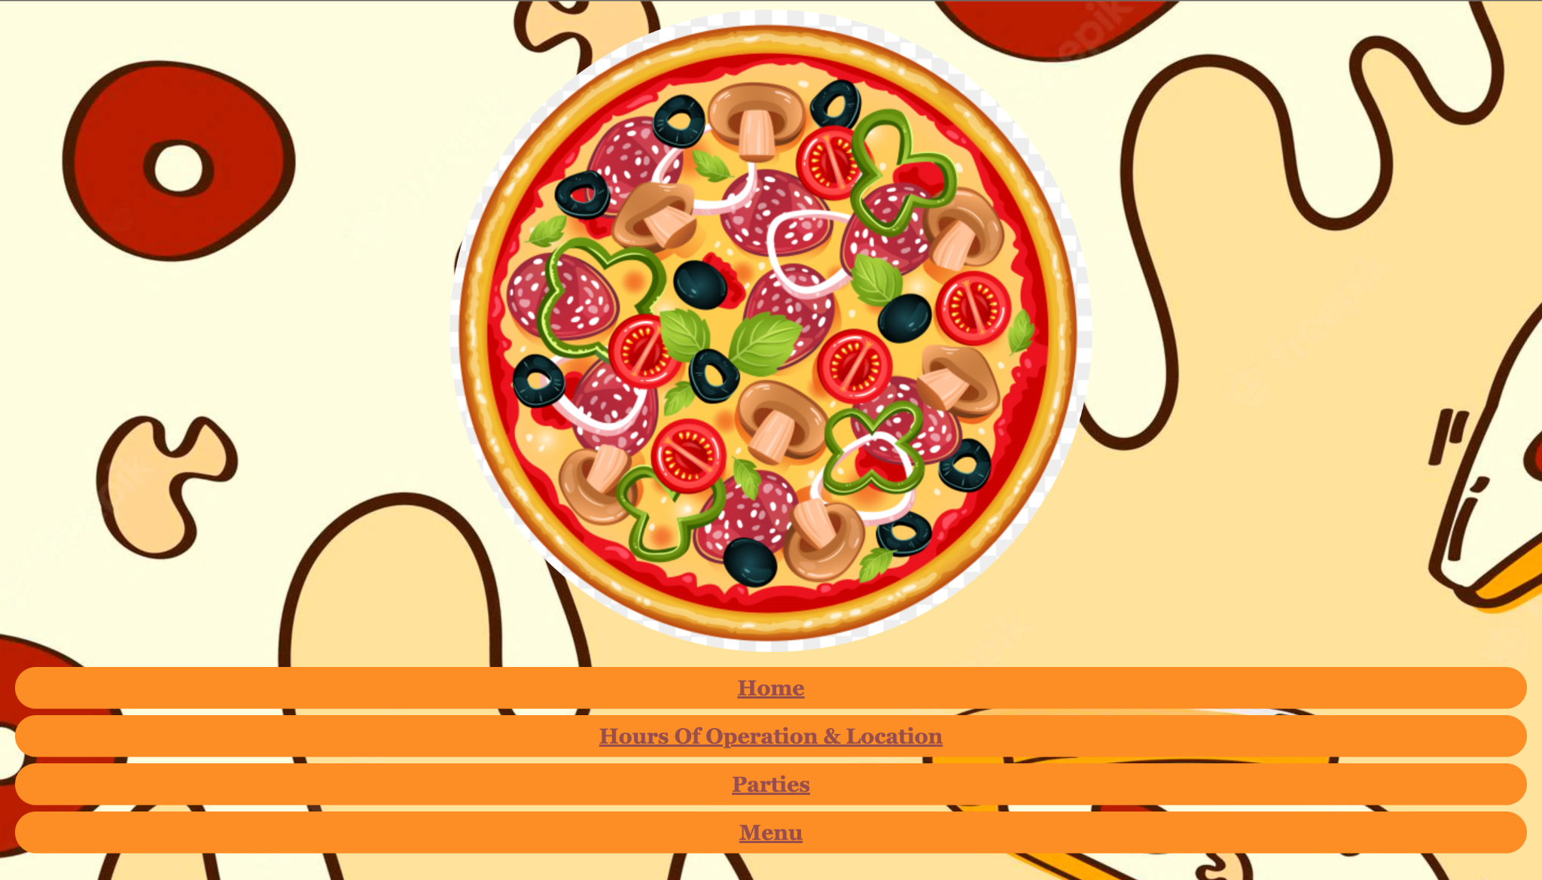
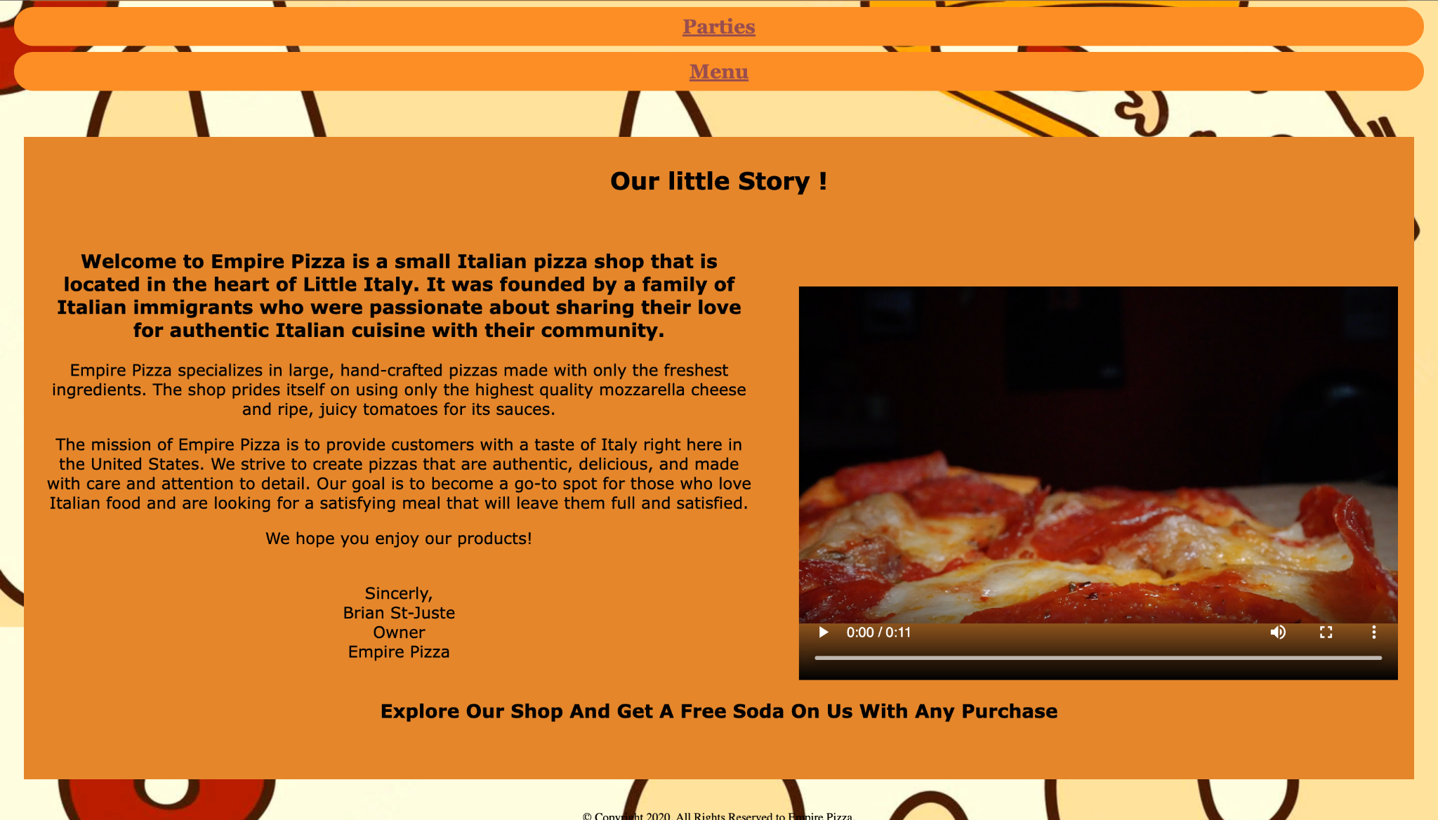
Home Page
Displays a pizza logo
Brief background of Empire State Pizza
Video of some delicious pizza

Slide 6
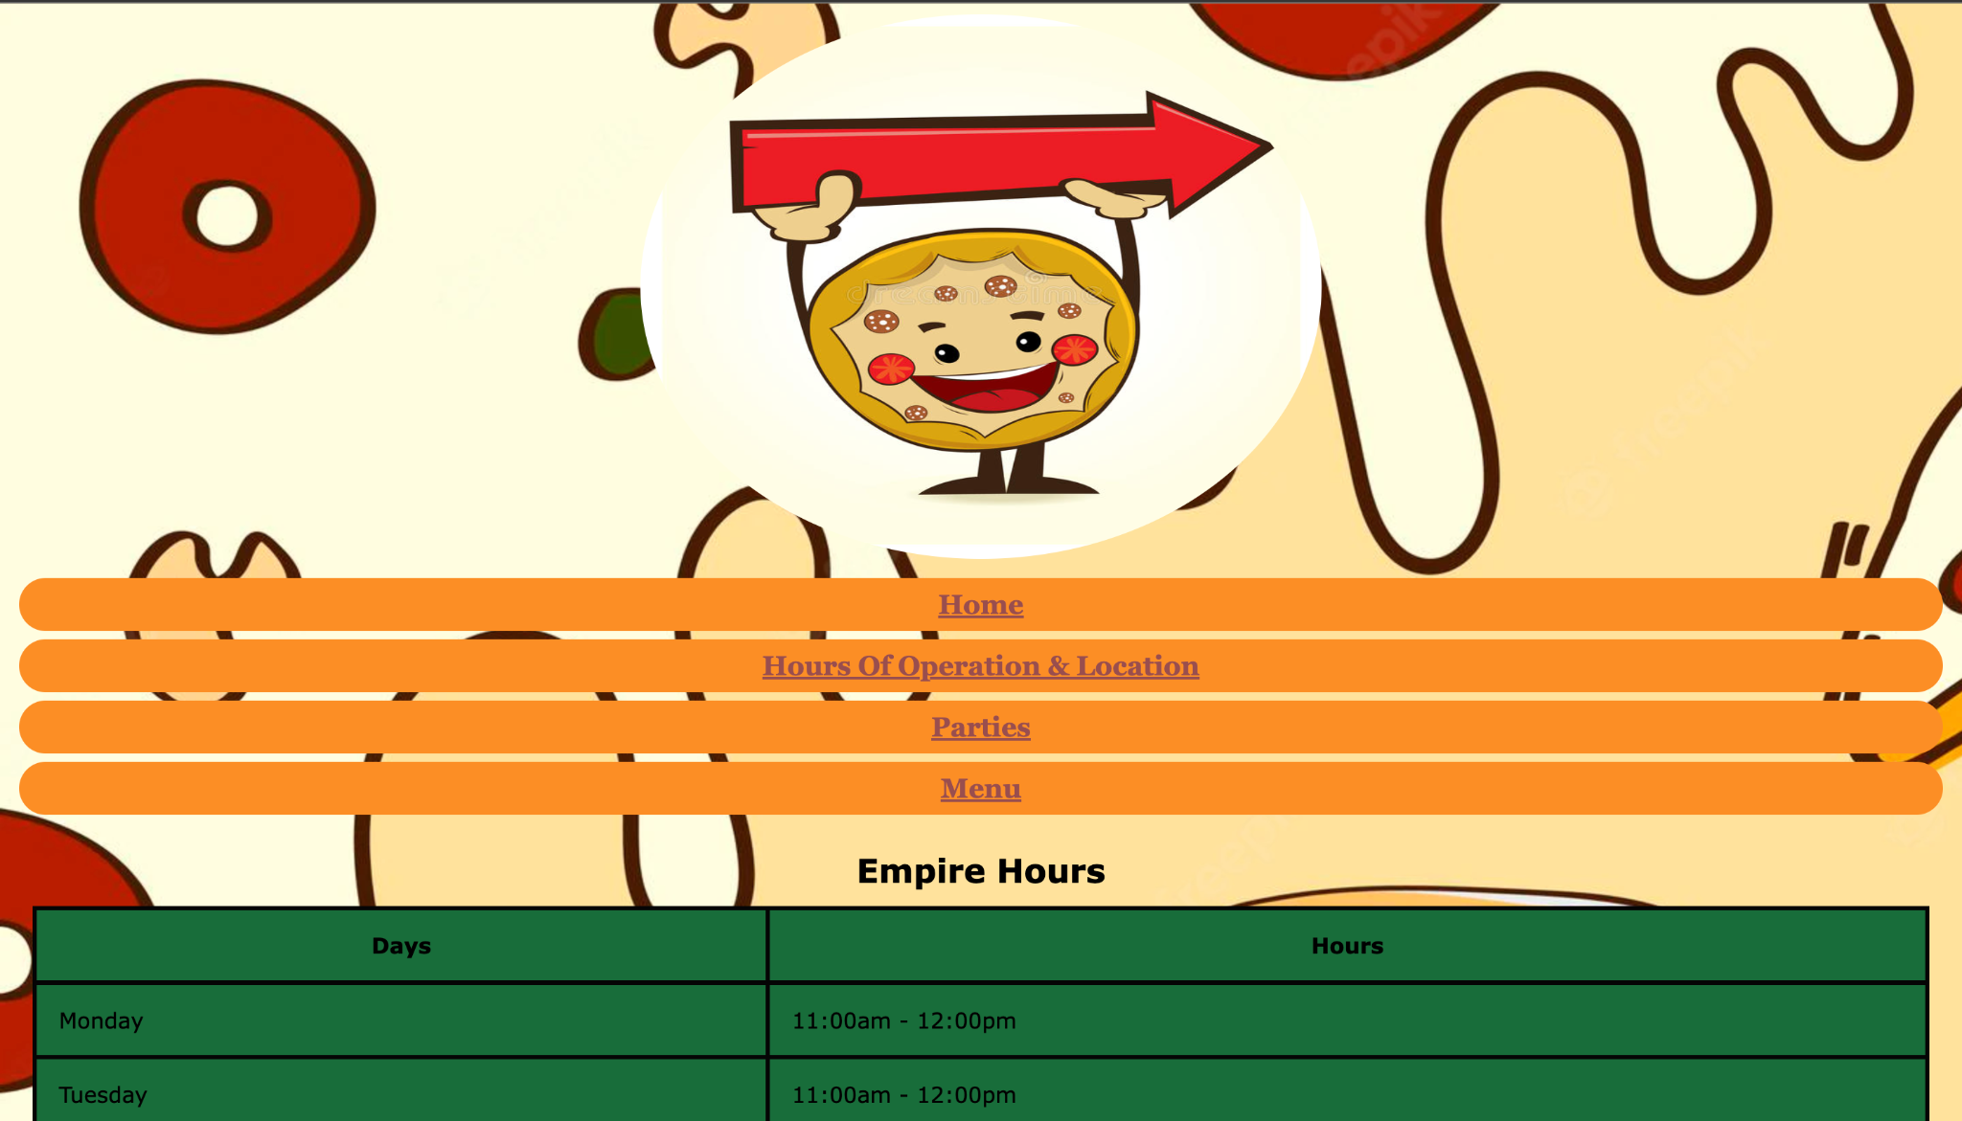
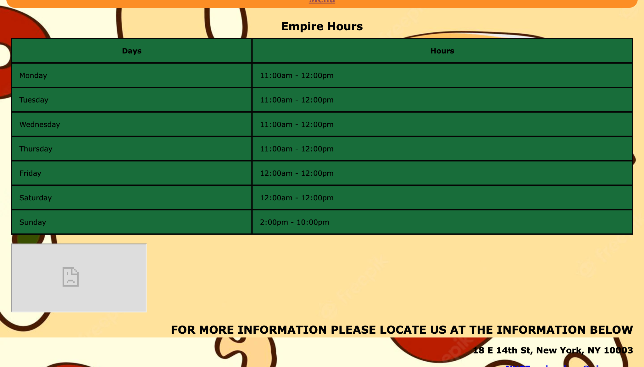
Hours & Location
This page shows our days and hours of operation
Our restaurant is open seven days of the week
Depending on the day that I was a differ.

Slide 7
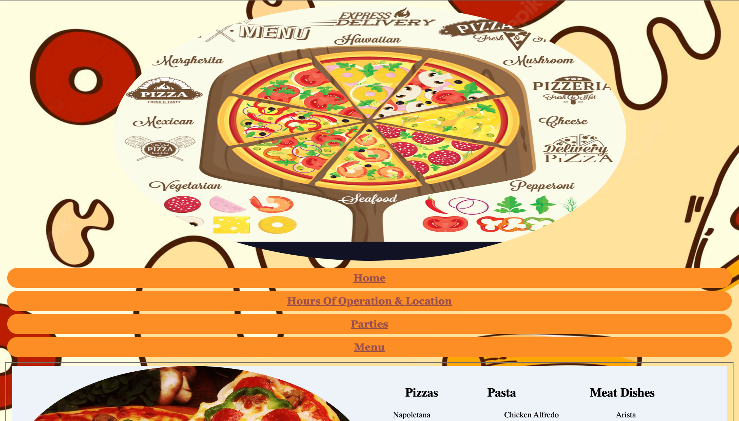
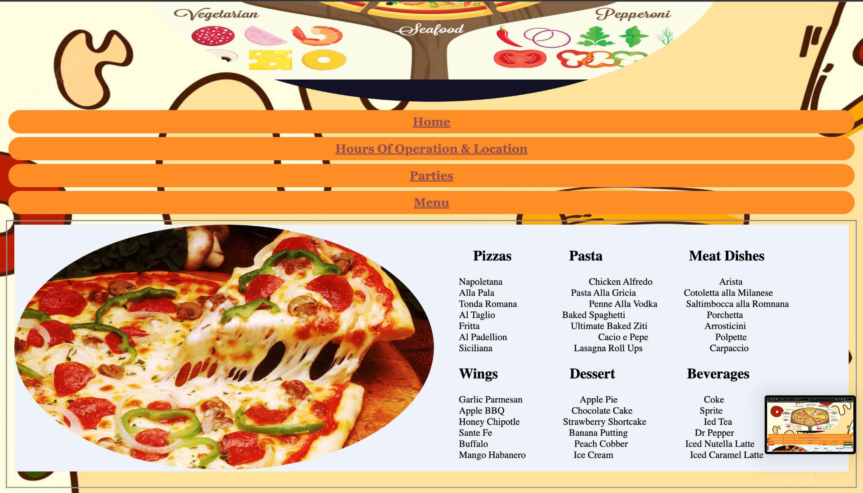
Menu
Our beautiful menu page displays all the menu items
There’s no size 4 the pizza because we only serve large pizza pies, we believe in go big, or go home.

Slide 8
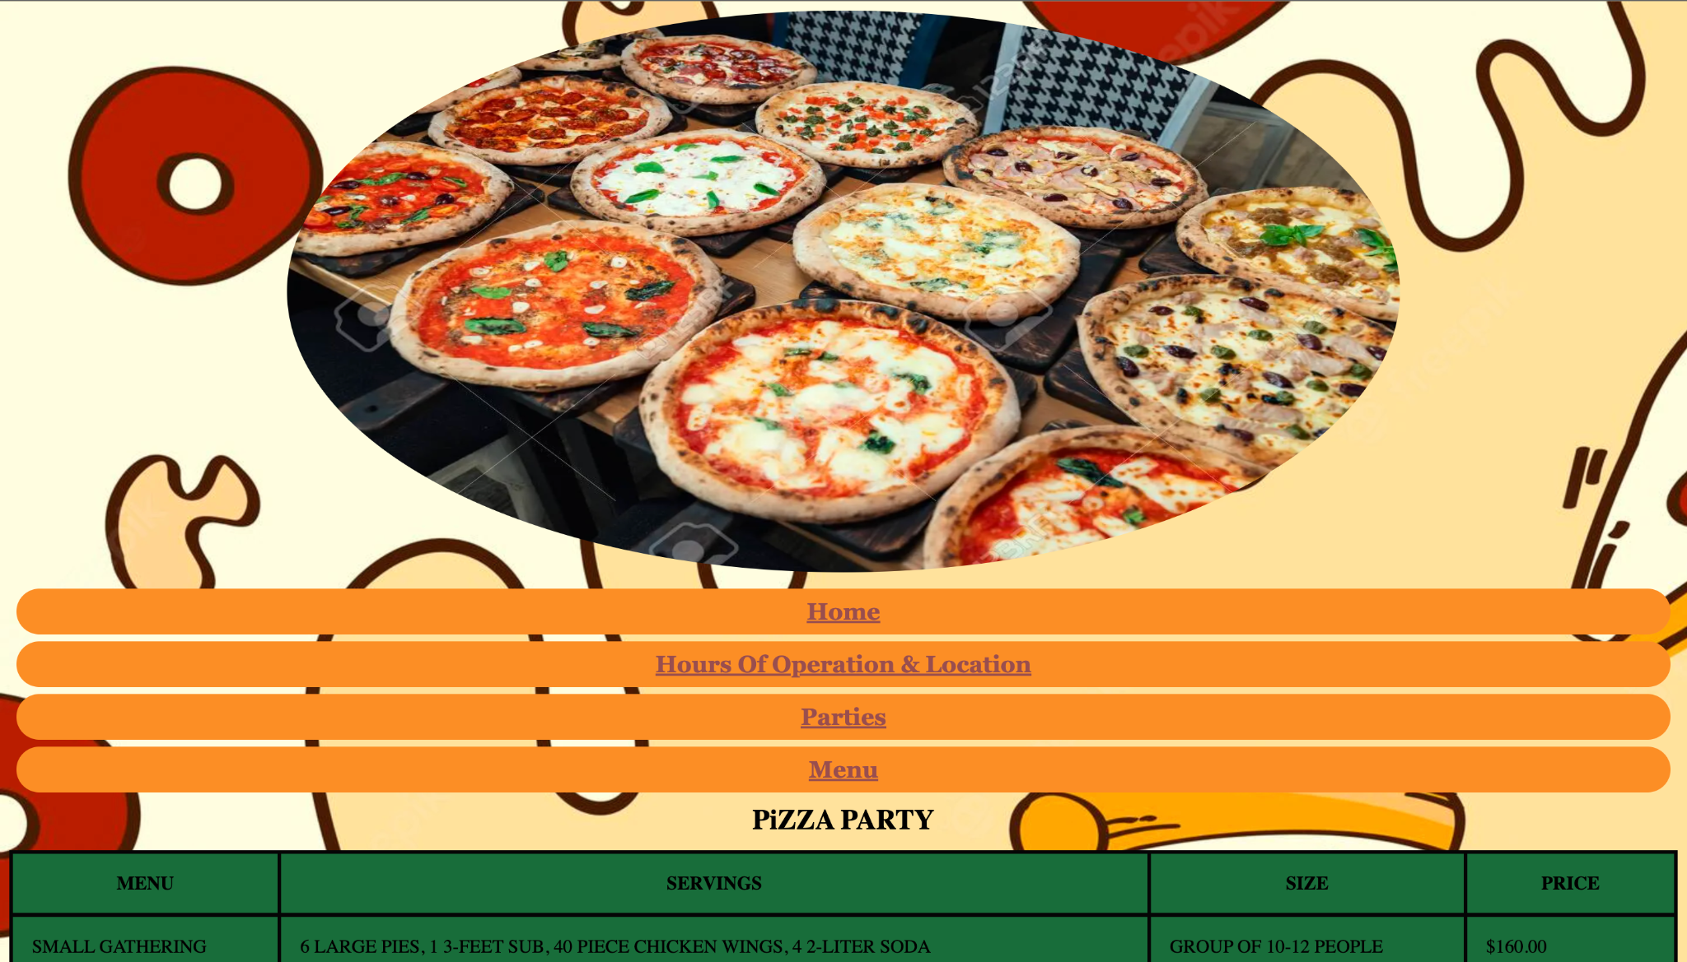
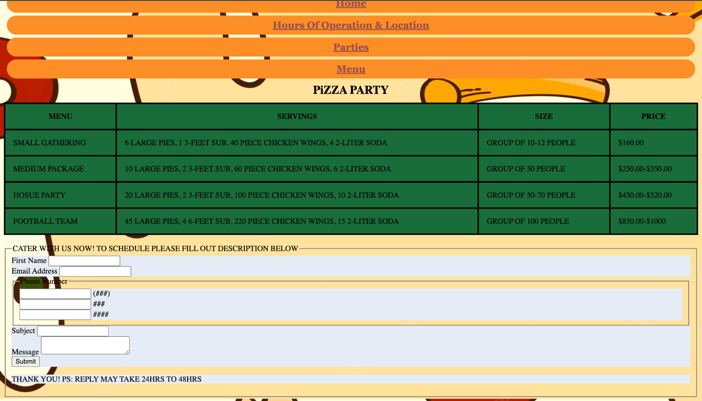
Party
This is our lovely party page where we do catering
At least once a week we cater to an event
For catering it’s a special order so we provide at the bottom of the page where you can input information and then we will get back to you in a tim

Slide 9
Code
<td>MEDIUM PACKAGE</td>
<td>10 LARGE PIES, 2 3-FEET SUB, 60 PIECE CHICKEN WINGS, 6 2-LITER SODA </td>
<td>GROUP OF 50 PEOPLE</td>
<td>$250.00-$350.00</td>
</tr>
<tr>
<td>HOSUE PARTY</td>
<td>20 LARGE PIES, 2 3-FEET SUB, 100 PIECE CHICKEN WINGS, 10 2-LITER SODA </td>
<td>GROUP OF 50-70 PEOPLE</td>
<td>$450.00-$520.00</td>
</tr>
<tr>
<td>FOOTBALL TEAM</td>
<td>45 LARGE PIES, 4 6-FEET SUB, 220 PIECE CHICKEN WINGS, 15 2-LITER SODA </td>
<td>GROUP OF 100 PEOPLE </td>
<td>$850.00-$1000</td>
</tr>
<html lang="en">
<head>
<link rel="stylesheet" href="Empire.css">
<title>Empire Pizza</title>
<meta charset="utf-8">
<meta name="viewport" content="width=device-width, initial-scale=1">
</head>
<!-- Use the header area for the website name or logo -->
<header>
<img src="partypizza.webp" alt="Empire Contact" width="950" height="480">

Slide 10
Conclusion
In addition to keeping the menu up to date, the website will also provide customers with the latest information about any special offers, events, or promotions that the restaurant is running. The website will also include a blog, where customers can read about the latest news and happenings at Empire Pizza, as well as interesting articles on pizza-related topics. We will also be adding a customer feedback section, where customers can share their thoughts and experiences with others. Overall, the website will be a valuable resource for anyone looking to stay up-to-date on what's happening at Empire Pizza.
https://www.w3schools.com/html/html_css.asp

